Slide 1
DATA MINING PROGECT
TEAM 8
Abdelrahman Ayman 2205033
Malak Mohamed 2205059
Fadya Hesham 2205177
Arsany Osama 2205122

Slide 2
Contents
In next slides we will talk about:
Dataset Used
1.1 Information about dataset
1.2 Where did we find it?
1.3 Why did we choose it specifically?
Analytical questions
2.1 What’s the percentage of boys to girls & who are successful among them?
2.2 How many absentees are there in each subject for each specialty?
2.3 What’s the percentage of different specializations & who’re the successful/fail ones?
2.4 Percentage of successful students in each governorate
2.5 The overall success rate of students in each subject
2.6 Who are the top ten students in each specialty?
2.7 Which administration and school has the highest average grades in Alexandria?
2.8 Did the majority pass the exams with a half grade in each subject? 2.9 Possible cheating rates in exams for each city
3. Application of Mining Techniques
3.1 The subject that most affects status by Classification Algorithm ( Decision Tree )
3.2 Possible grades that were added to the failing student to pass the exam ) K-Medoids )
3.3 Classifying students’ level in each subject using advanced clustering ( Fuzzy )
3.4 The relationship between each subject and grouping similar ones ( Hierarchical )

Slide 3
DatasetUsed
001
Basic informations about data

Slide 4
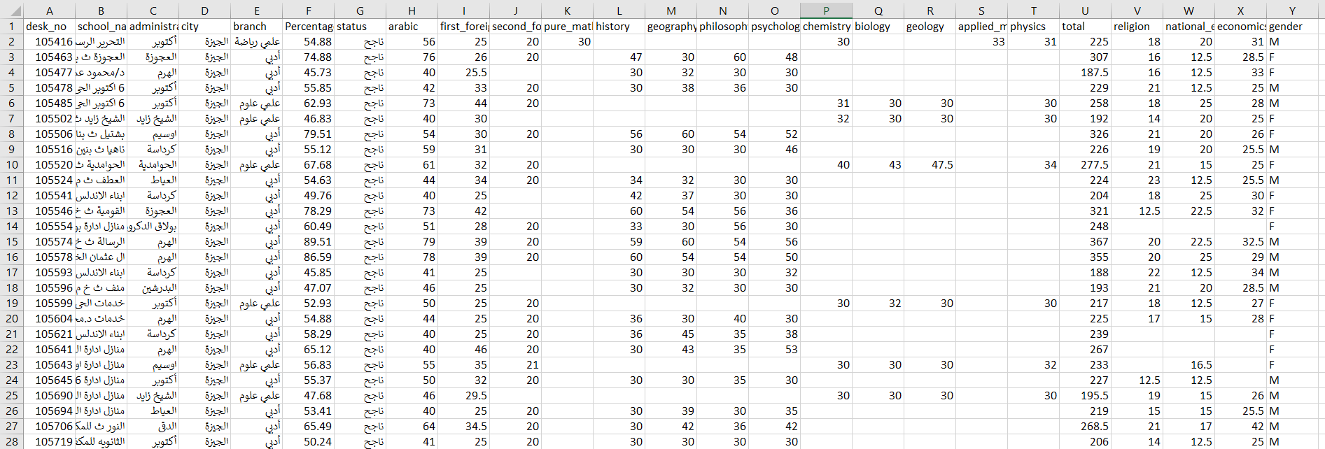
1.1 Information about dataset . We have chosen a dataset about the results of high school students, especially the second round . It consists of 153,833 rows and 25 columns . The columns are as follows:
—High_School_Public_Results_2022_EG_second_attempt

Slide 5
1.2 Where did we find it?
We found it on Kaggle.com
(https://www.kaggle.com/datasets/mohamedahmedx2/high-school-public-results-2022-eg) This dataset is approved by the Egyptian Ministry of Education for the year 2022 by Minister Tarek Shawky.
1.3 Why did we choose it specifically?
Because this data actually represents us before we entered the university,
so we are sufficiently familiar with it and we can deal with it easier than any
other data that is new to us.
This data also fulfills the required conditions, and we mentioned before that it is the results of the second round, because its size is smaller, which allows us to run faster on Jupyter.

Slide 6
02
General analytical questions
Some important statistics to know about this data

Slide 7
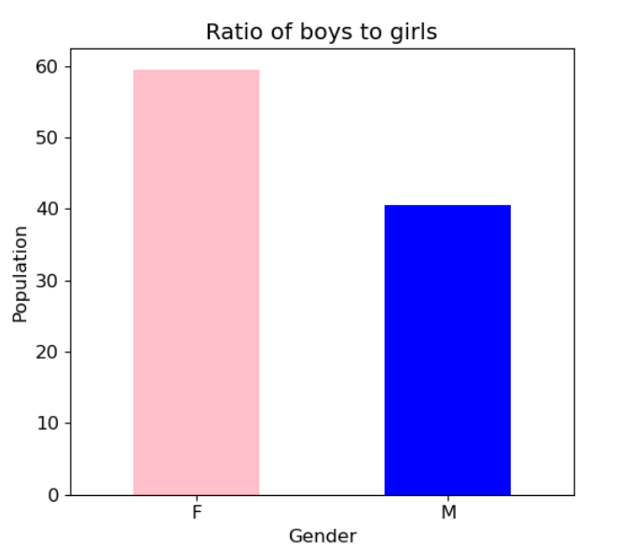
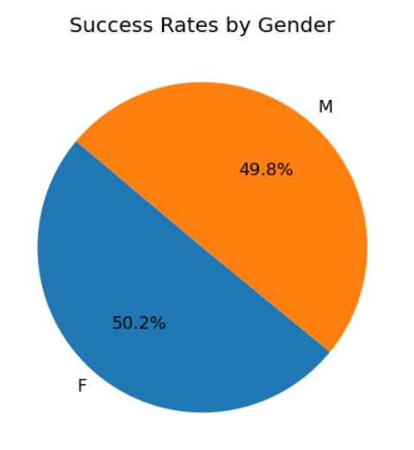
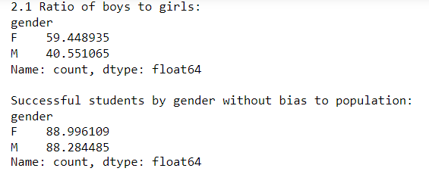
01
02
03
Success rate for both
Printed Data
Percentage In general
2.1 What’s the percentage of boys to girls & who are successful among them?
The results are shown as follows:
Percentage In general
Boys : 40.551065, & Girls : 59.448935
Which means that the majority of students taking the exams are girls
Success rate for both of them With respect to the number difference between them (divided by the total number of each)
Boys : 49.8 & Girls : 50.2

Slide 8
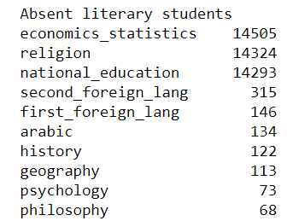
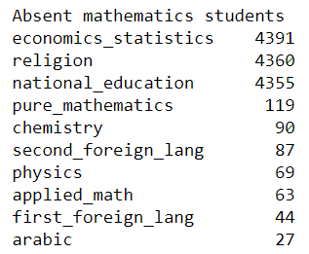
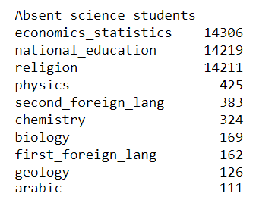
2.2 How many absentees are there in each subject for each specialty?

Slide 9
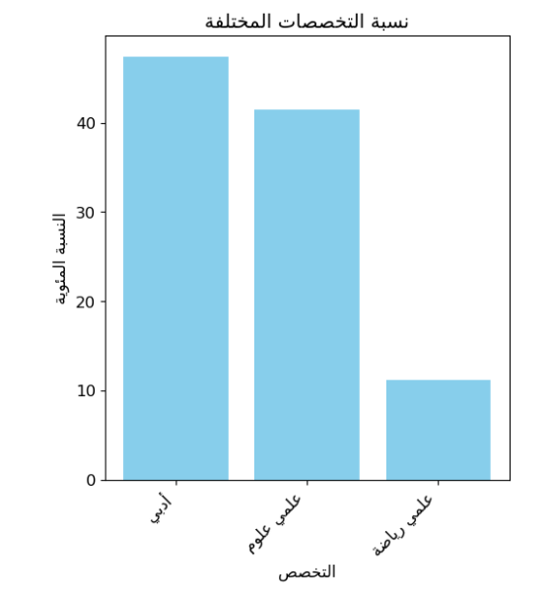
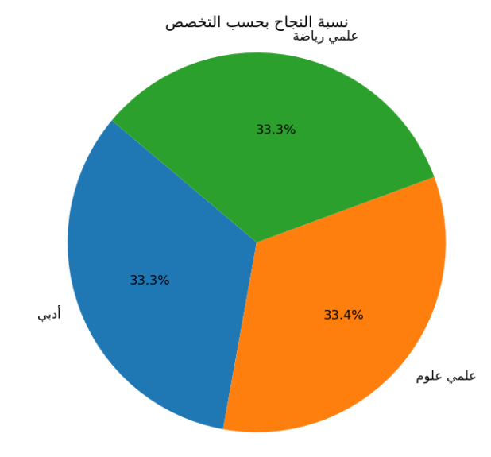
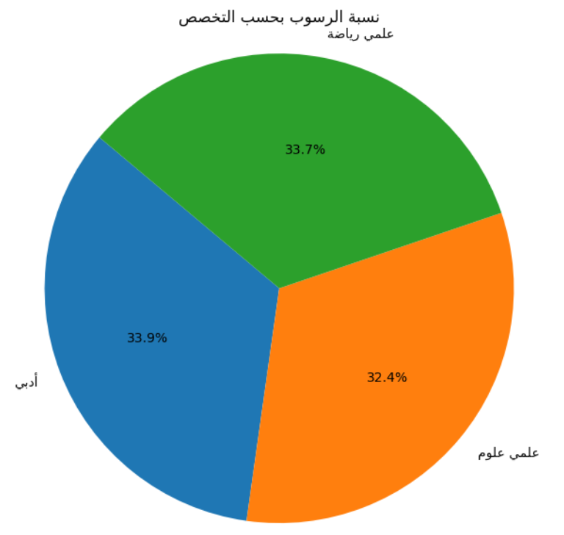
2.3 What’s the percentage of different specializations & who’re the successful/fail ones?
Percentage of different specializations
Successful students by specialization
Failing students according to specialization
Most of the students are majoring in literature and the minority in mathematics
Almost all the same percentages with a very slight success advantage for science students
Most of the students who fail are literary students

Slide 10
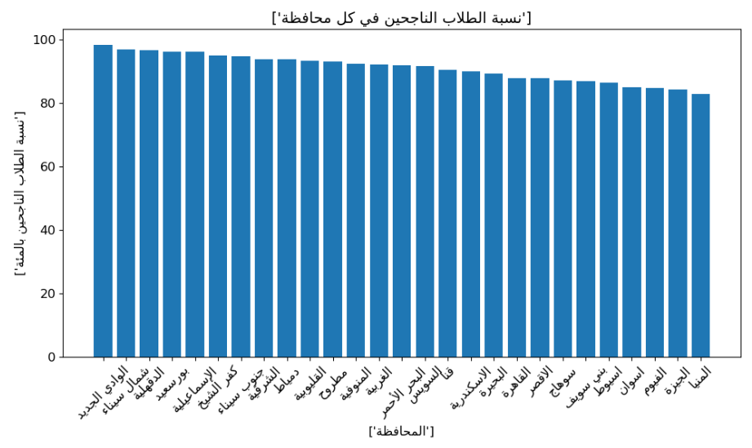
2.4 Percentage of successful students in each governorate
New Valley is the most superior to the rest of the 26 governorates

Slide 11
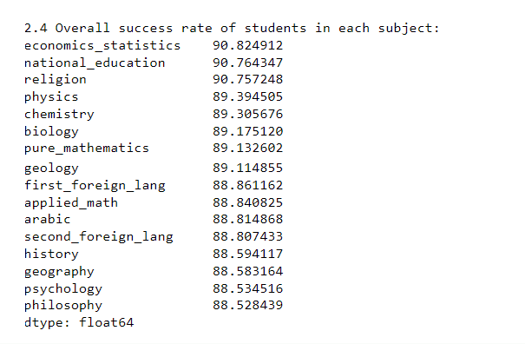
2.5 The overall success rate of students in each subject
It is clear from these statistics that the most successful subjects are subjects outside the general secondary school grade
We can know that the least successful subjects in the literary major are philosophy
Also the least in mathematics is applied mathematics
& least in science is geology

Slide 12
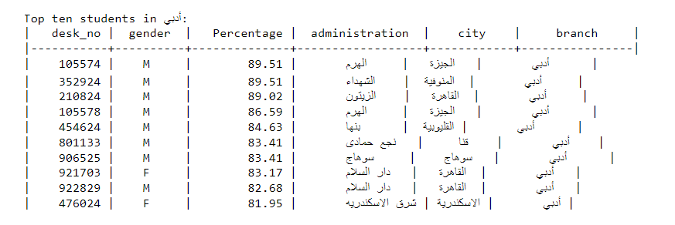
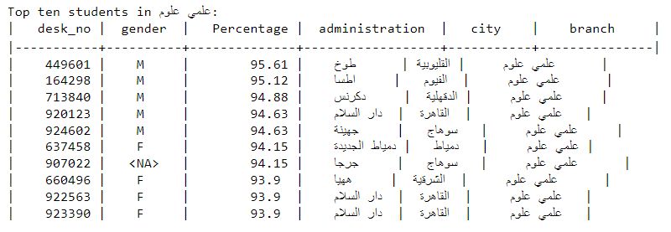
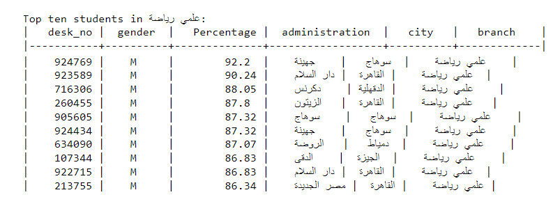
2.6 Who are the top ten students in each specialty?
Literary students
Science students
Mathematics students

Slide 13
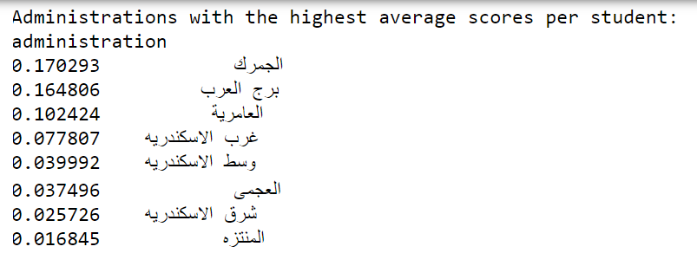
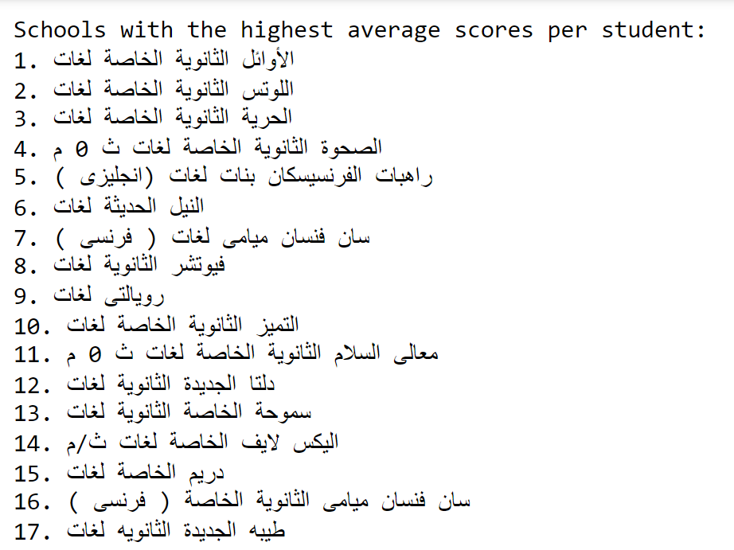
2.7 Which administration and school has the highest average grades in Alexandria?

Slide 14
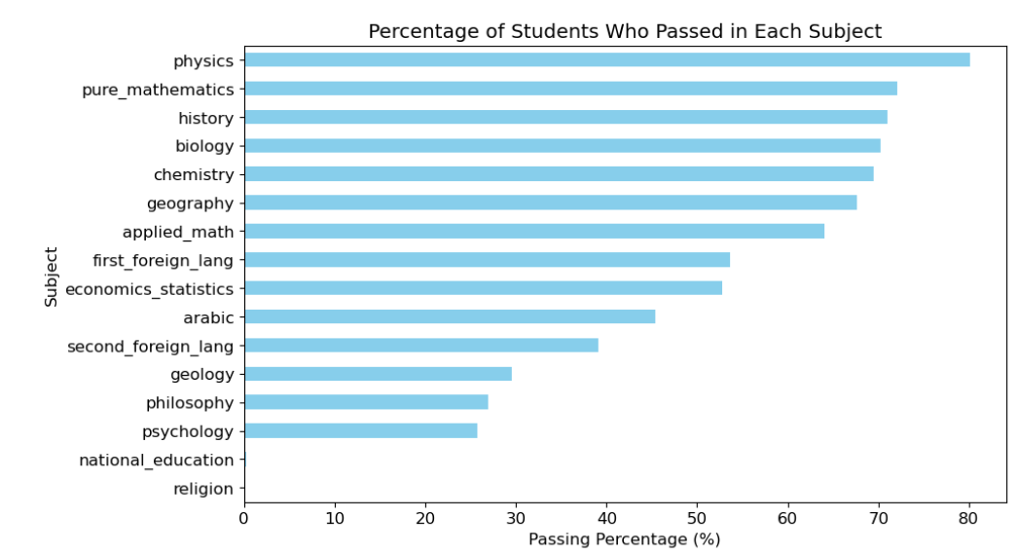
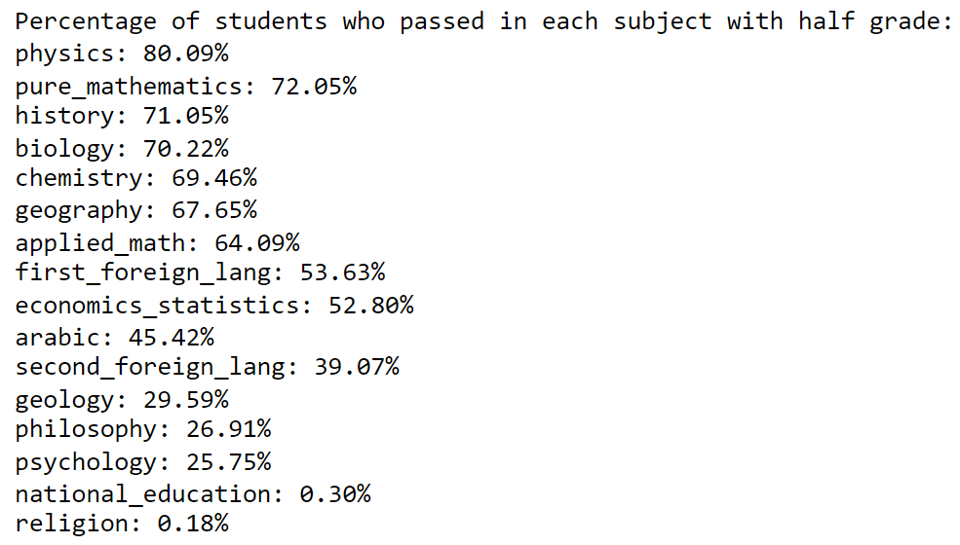
2.8 Did the majority pass the exams with a half grade in each subject?
It is clear from the two pictures that a large portion of the students passed the exams with half a grade for the subject, especially physics

Slide 15
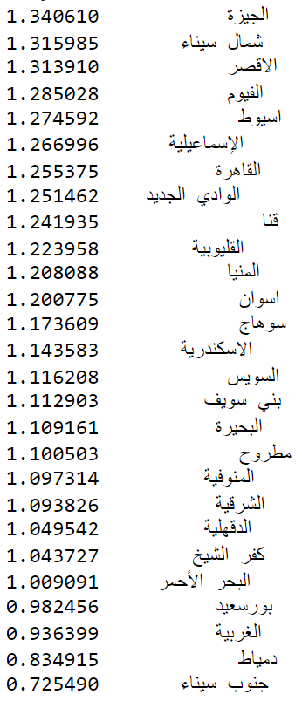
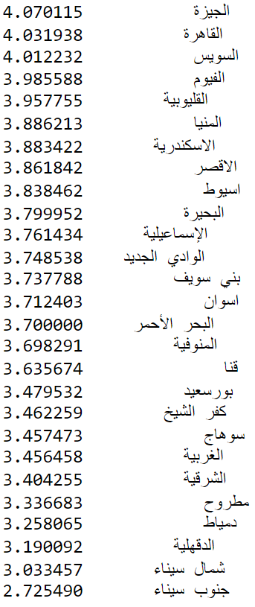
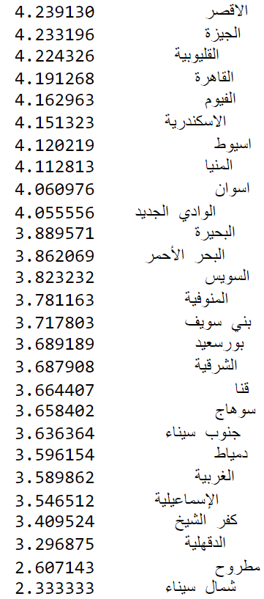
2.9 Possible cheating rates in exams for each city !
Literary
Sciences
Mathematics

Slide 16
Application of Mining Techniques
003
Classification - ….

Slide 17
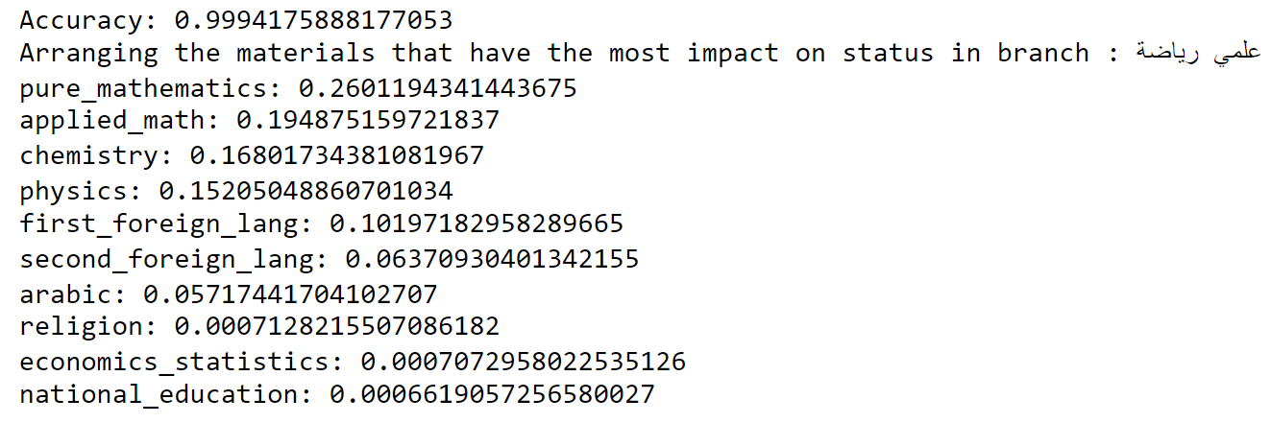
3.1 The subject that most affects status
Accuracy: The effect of all mathematical subjects on the student’s status, whether he passed or failed
We note that the most influential subjects this time are mathematics specialization subjects, which means that they are relatively difficult than the rest of the subjects

Slide 18
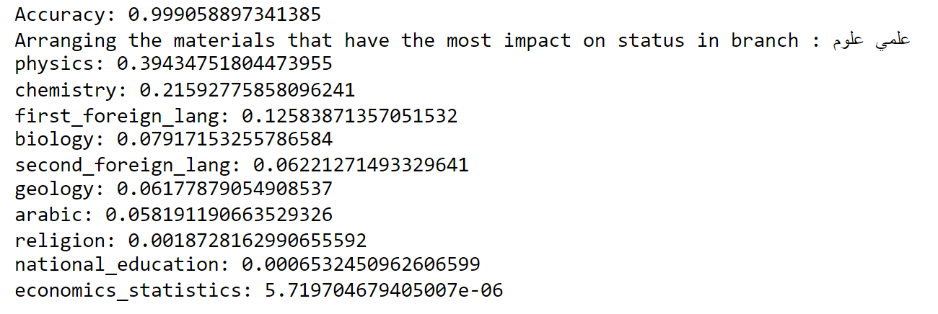
3.1 The subject that most affects status
Accuracy: The effect of all Sciences subjects on the student’s status, whether he passed or failed
Here we notice that the most influential subject is physics, and this is somewhat logical because most science students are not sufficiently trained in mathematics, like mathematics students.

Slide 19
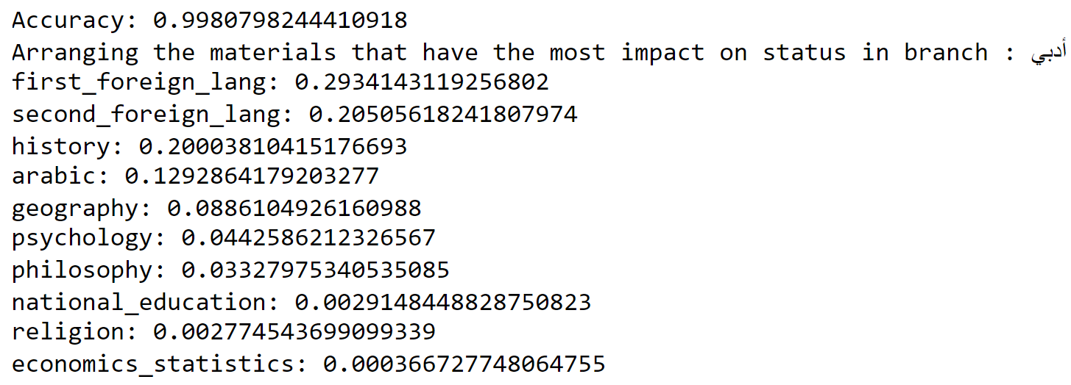
3.1 The subject that most affects status
Accuracy: This means that all literary materials have an impact on the student’s status, whether he passed or failed
In literature, we notice that the most influential subjects are language subjects, which means that students are more interested in literary subjects, and this has led to language subjects being relatively ignored.

Slide 20
3.2 Possible grades that were added to the failing student to pass the exam )K-Medoids clustering)
We applied the K-medoids algorithm to about more than half of the sample data to reduce calculations while running the code
The evaluation of students’ performance in Clusters for each subject was based on the Silhouette method, which tests the k from 2 to 10 and chooses the best k, and this is detailed in the report.
Any student for whom the subject was not prescribed was removed, and those who received a zero were often due to a cheating report being filed against them

Slide 21
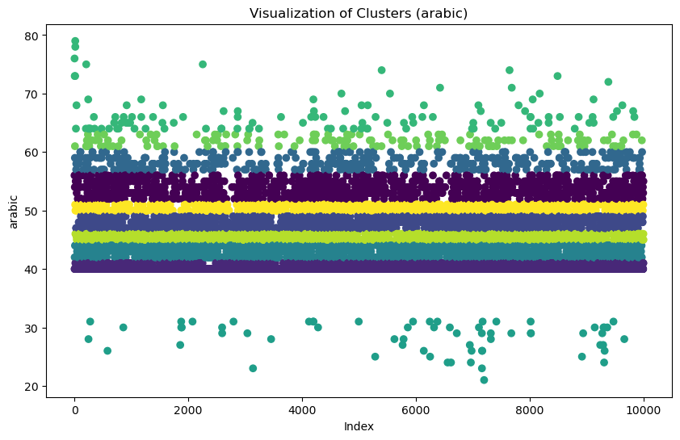
3.2 Possible grades that were added to the failing student to pass the exam )K-Medoids clustering)
Arabic
Divided into 10 clusters
There is a failing grade in the subject in the range of 20 to 31
This means that whoever scored 32 or above was raised to the passing grade of 40, which shows huge density. (+8)

Slide 22
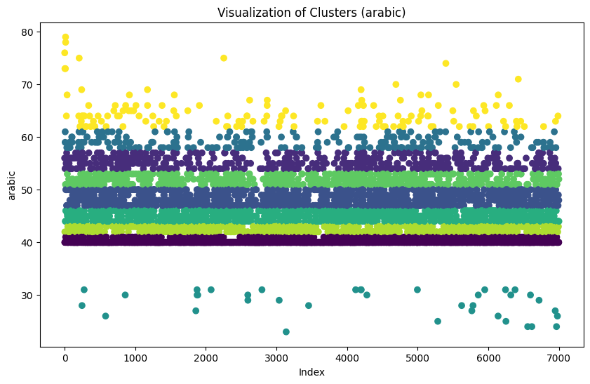
3.2 Possible grades that were added to the failing student to pass the exam )K-Means clustering)
Arabic (Compared to K-medoids)
Here the data is divided into 9 clusters only, and this indicates that k-medoids deal better with outliers.
And so on for the rest of the subjects

Slide 23
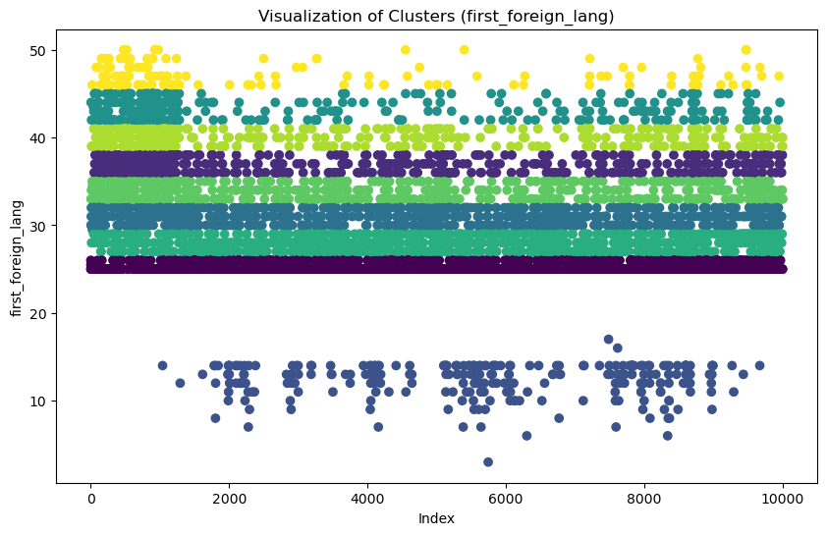
3.2 Possible grades that were added to the failing student to pass the exam )K-Medoids clustering)
b) First foreign language
Divided into 9 clusters
There is a failing grade in the subject in the range of 8 to 15
This means that whoever scored 16 or above was raised to the passing grade of 25, which shows huge density. (+9)
The meaning of the high density at the beginning of the graph is the cleverness of the governorate entered first, which is Giza

Slide 24
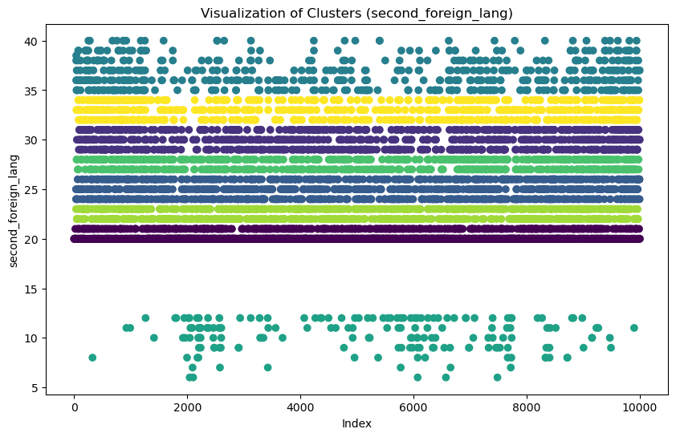
3.2 Possible grades that were added to the failing student to pass the exam )K-Medoids clustering)
c) Second foreign language
Divided into 8 clusters
There is a failing grade in the subject in the range of 6 to 13
This means that whoever scored 14 or above was raised to the passing grade of 20, which shows huge density. (+6)

Slide 25
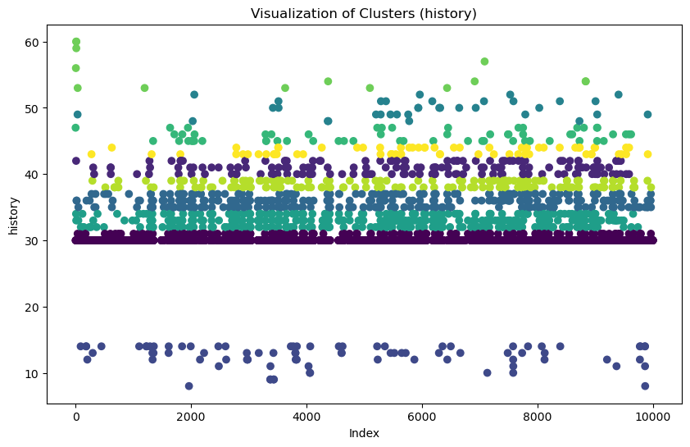
3.2 Possible grades that were added to the failing student to pass the exam )K-Medoids clustering)
d) History
Divided into 10 clusters
There is a failing grade in the subject in the range of 9 to 14
This means that whoever scored 15 or above was raised to the passing grade of 30, which shows huge density. (+15)

Slide 26
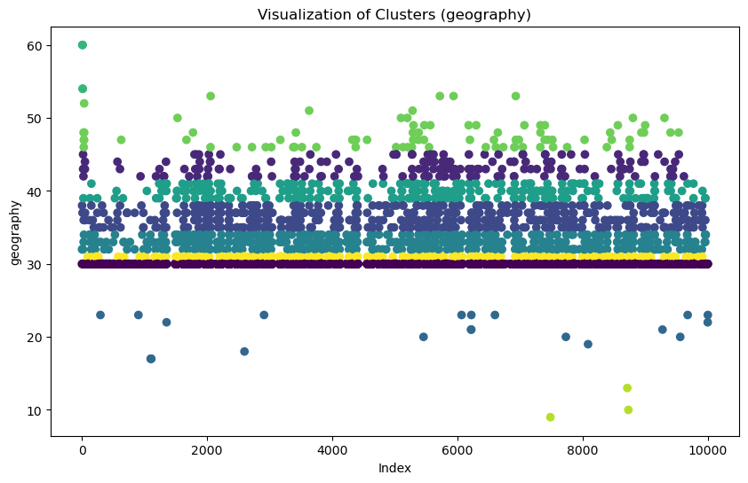
3.2 Possible grades that were added to the failing student to pass the exam )K-Medoids clustering)
e) Geography
Divided into 10 clusters
There is a failing grade in the subject in the range of 9 to 23
This means that whoever scored 24 or above was raised to the passing grade of 30, which shows huge density. (+6)

Slide 27
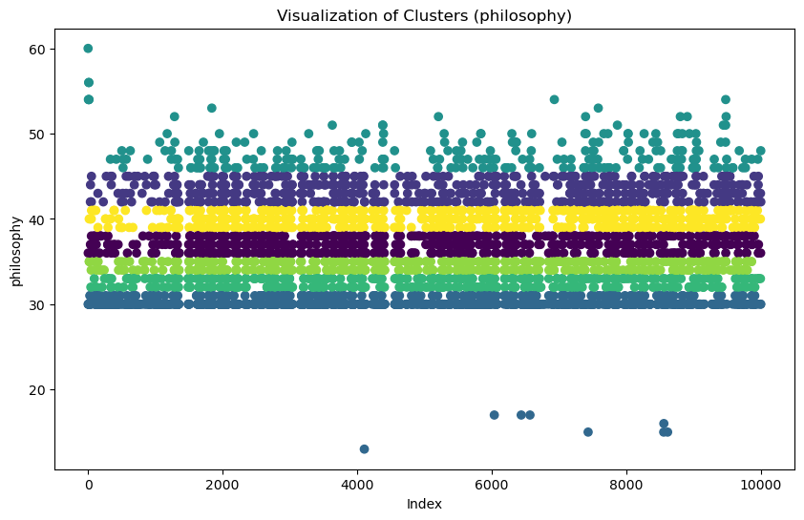
3.2 Possible grades that were added to the failing student to pass the exam )K-Medoids clustering)
f) Philosophy
Divided into 7 clusters
There is a failing grade in the subject in the range of 4 to 16
This means that whoever scored 17 or above was raised to the passing grade of 30, which shows huge density. (+13)

Slide 28
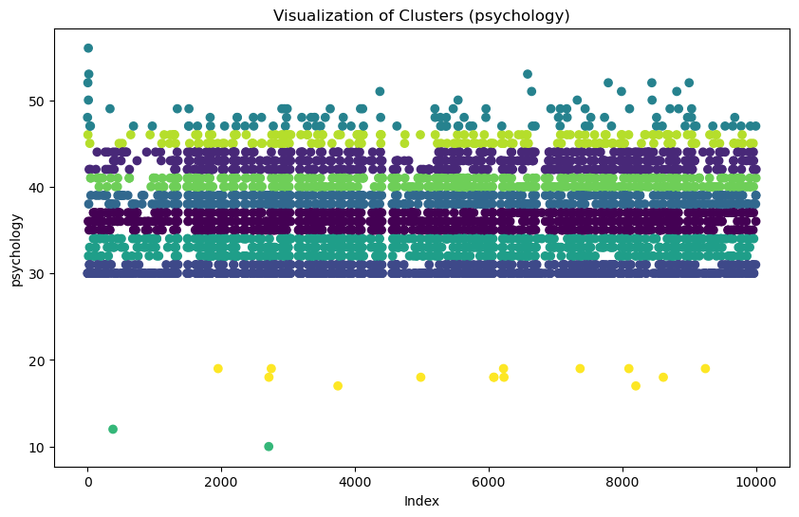
3.2 Possible grades that were added to the failing student to pass the exam )K-Medoids clustering)
g) Psychology
Divided into 10 clusters
There is a failing grade in the subject in the range of 10 to 19
This means that whoever scored 20 or above was raised to the passing grade of 30, which shows huge density. (+10)

Slide 29
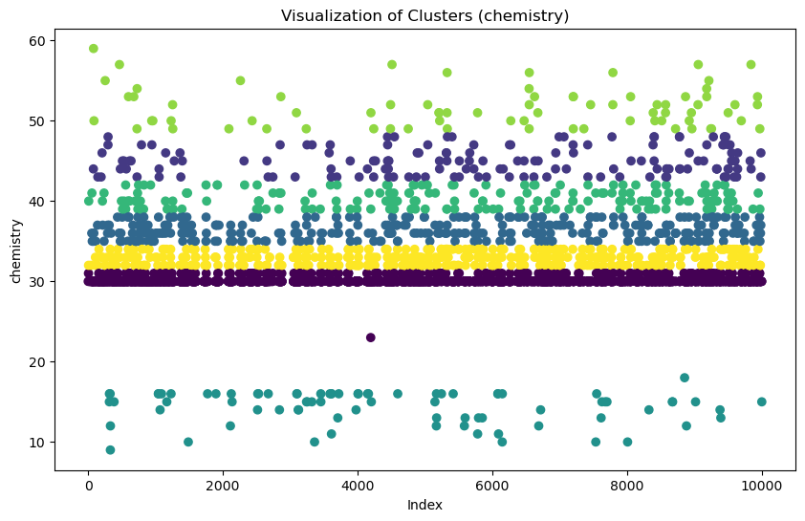
3.2 Possible grades that were added to the failing student to pass the exam )K-Medoids clustering)
h) Chemistry
Divided into 7 clusters
There is a failing grade in the subject in the range of 9 to 22
This means that whoever scored 23 or above was raised to the passing grade of 30, which shows huge density. (+7)

Slide 30
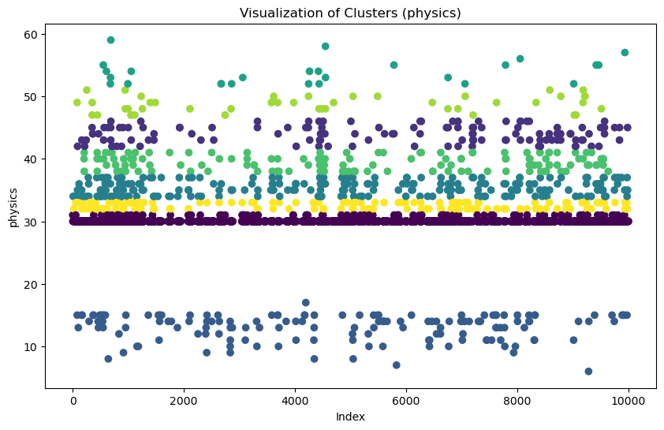
3.2 Possible grades that were added to the failing student to pass the exam )K-Medoids clustering)
i) Physics
Divided into 8 clusters
There is a failing grade in the subject in the range of 4 to 18
This means that whoever scored 19 or above was raised to the passing grade of 30, which shows huge density. (+11)

Slide 31
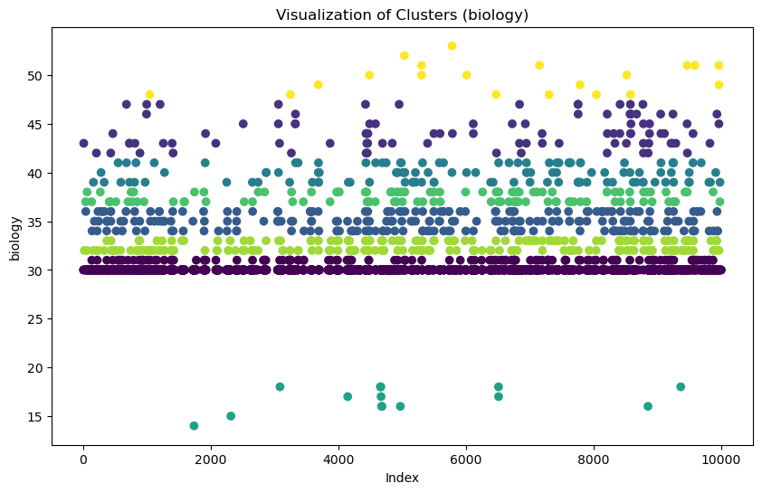
3.2 Possible grades that were added to the failing student to pass the exam )K-Medoids clustering)
j) Biology
Divided into 8 clusters
There is a failing grade in the subject in the range of 13 to 19
This means that whoever scored 20 or above was raised to the passing grade of 30, which shows huge density. (+10)

Slide 32
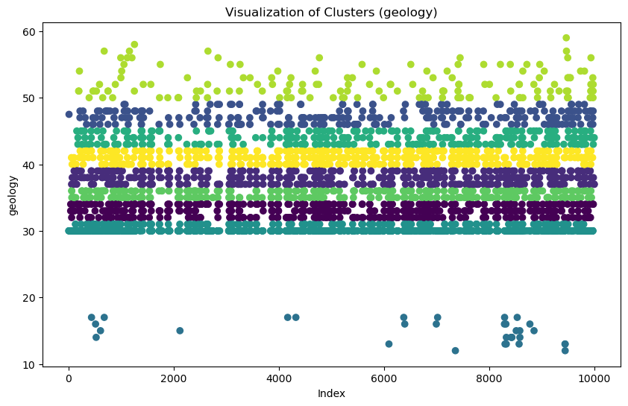
3.2 Possible grades that were added to the failing student to pass the exam )K-Medoids clustering)
k) Geology
Divided into 9 clusters
There is a failing grade in the subject in the range of 12 to 18
This means that whoever scored 19 or above was raised to the passing grade of 30, which shows huge density. (+11)

Slide 33
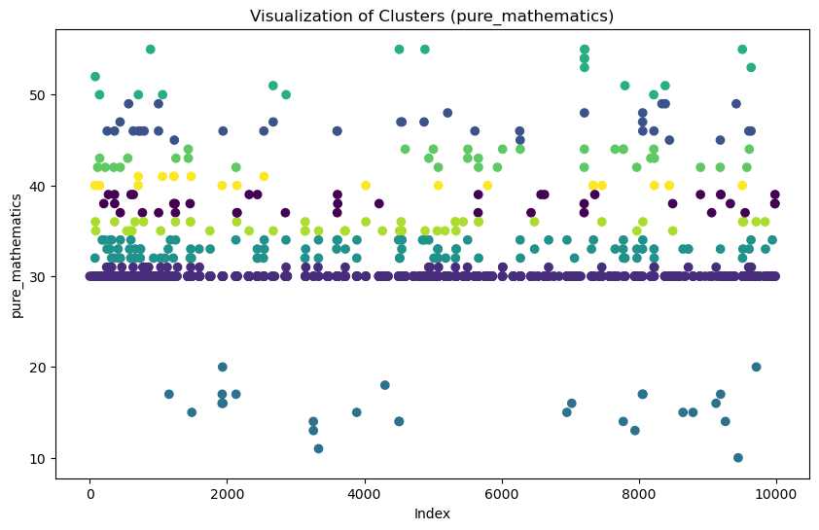
3.2 Possible grades that were added to the failing student to pass the exam )K-Medoids clustering)
l) Pure Mathematics
Divided into 9 clusters
There is a failing grade in the subject in the range of 11 to 20
This means that whoever scored 21 or above was raised to the passing grade of 30, which shows huge density. (+9)

Slide 34
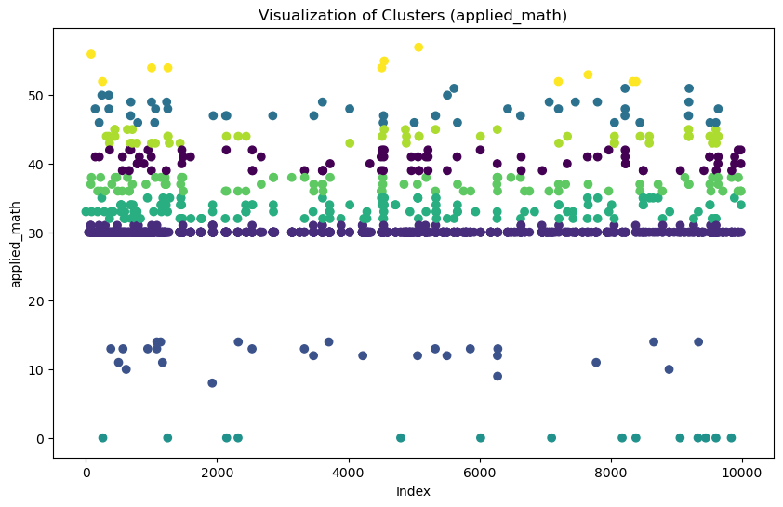
3.2 Possible grades that were added to the failing student to pass the exam )K-Medoids clustering)
m) Applied Mathematics
Divided into 9 clusters
There is a failing grade in the subject in the range of 9 to 15
This means that whoever scored 16 or above was raised to the passing grade of 30, which shows huge density. (+14)

Slide 35
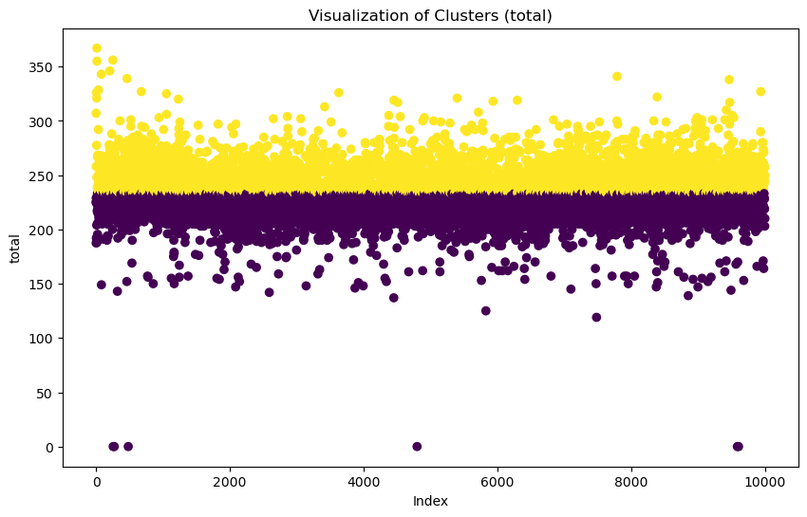
3.2 Possible grades that were added to the failing student to pass the exam )K-Medoids clustering)
Finally, Total score
Divided into 2 clusters
The data is divided exactly by the 240, those in yellow have a good level according to the k-means distribution
Half of the total score is 205, so dividing the data at 240 means that there are more successful students, and this has been proven before in the dataset analysis.

Slide 36
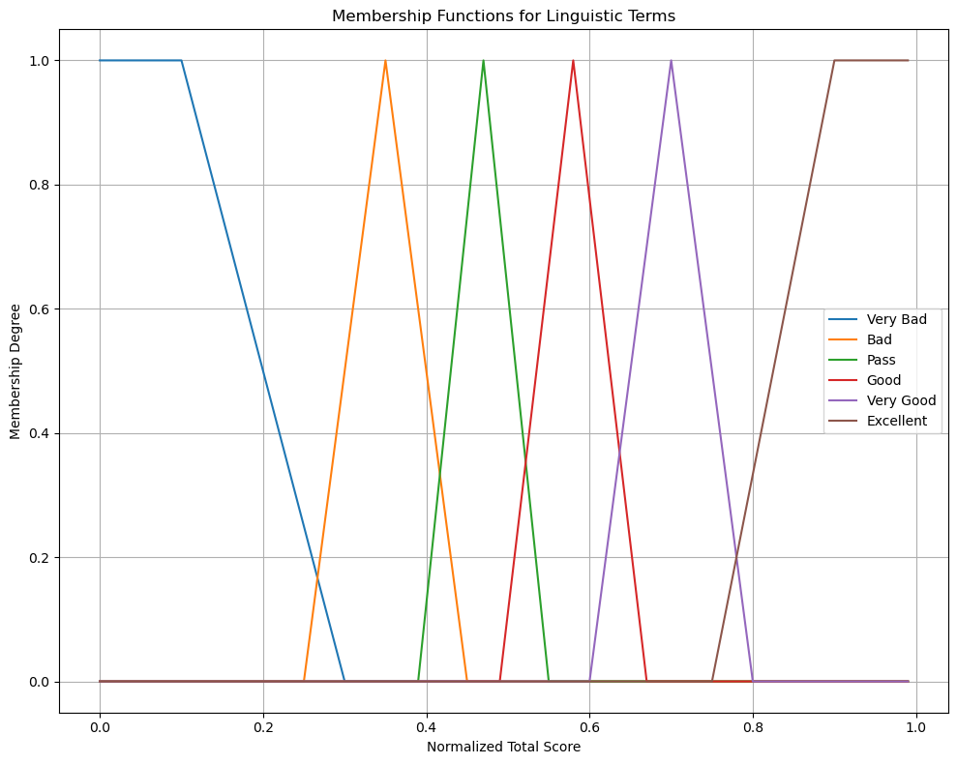
3.3 Classifying students’ level in each subject using advanced clustering ( Fuzzy )
Using this membership function, in which we assumed that :
(Normalized data by MinMax Scaler)
Very bad from 0 to 0.3
Bad from 0.25 to 0.45
Pass from 0.39 to 0.55
Good from 0.49 to 0.67
Very Good from 0.6 to 0.8
Excellent from 0.75 to 1

Slide 37
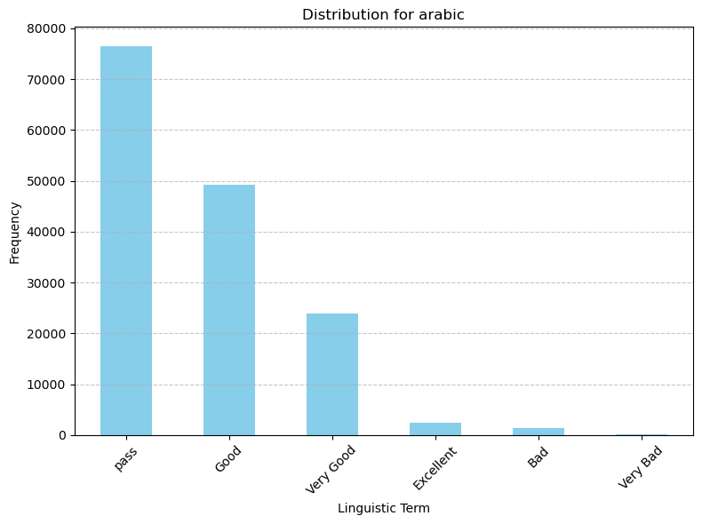
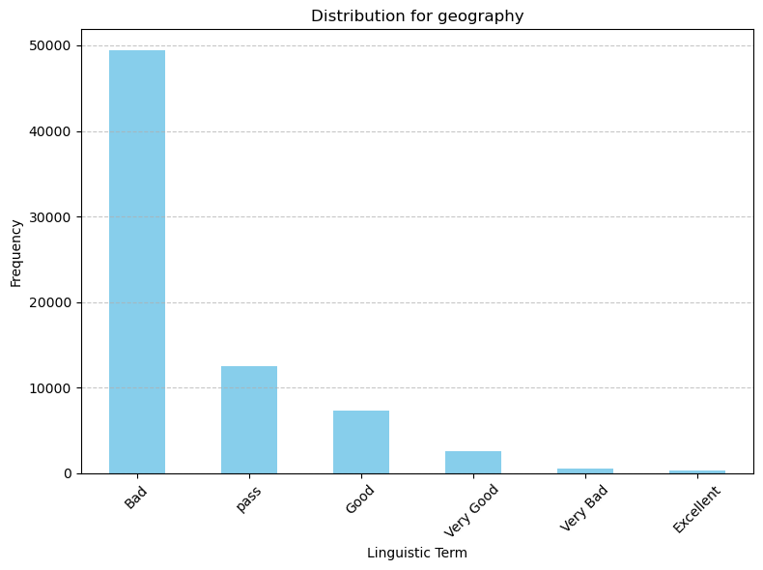
3.3 Classifying students’ level in each subject using advanced clustering ( Fuzzy )
This is the data for the Arabic language exam, and because this data is for second-year students, we notice logically that most of the students are at the pass level.
And so on for the rest of the subjects, except for geography and the total grades
This also proves why the failure rate in literature was the majority

Slide 38
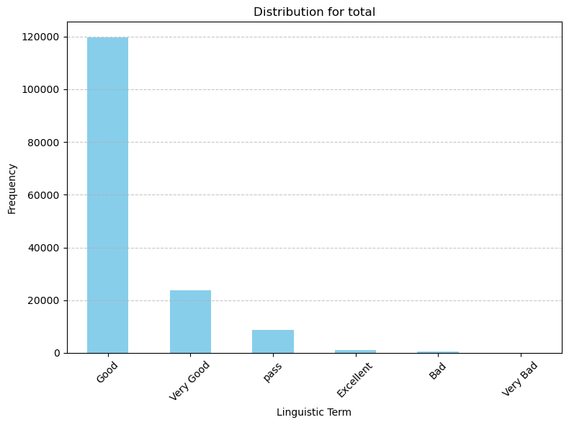
3.3 Classifying students’ level in each subject using advanced clustering ( Fuzzy )
This graph shows that the total number of people who took the second round exam is good

Slide 39
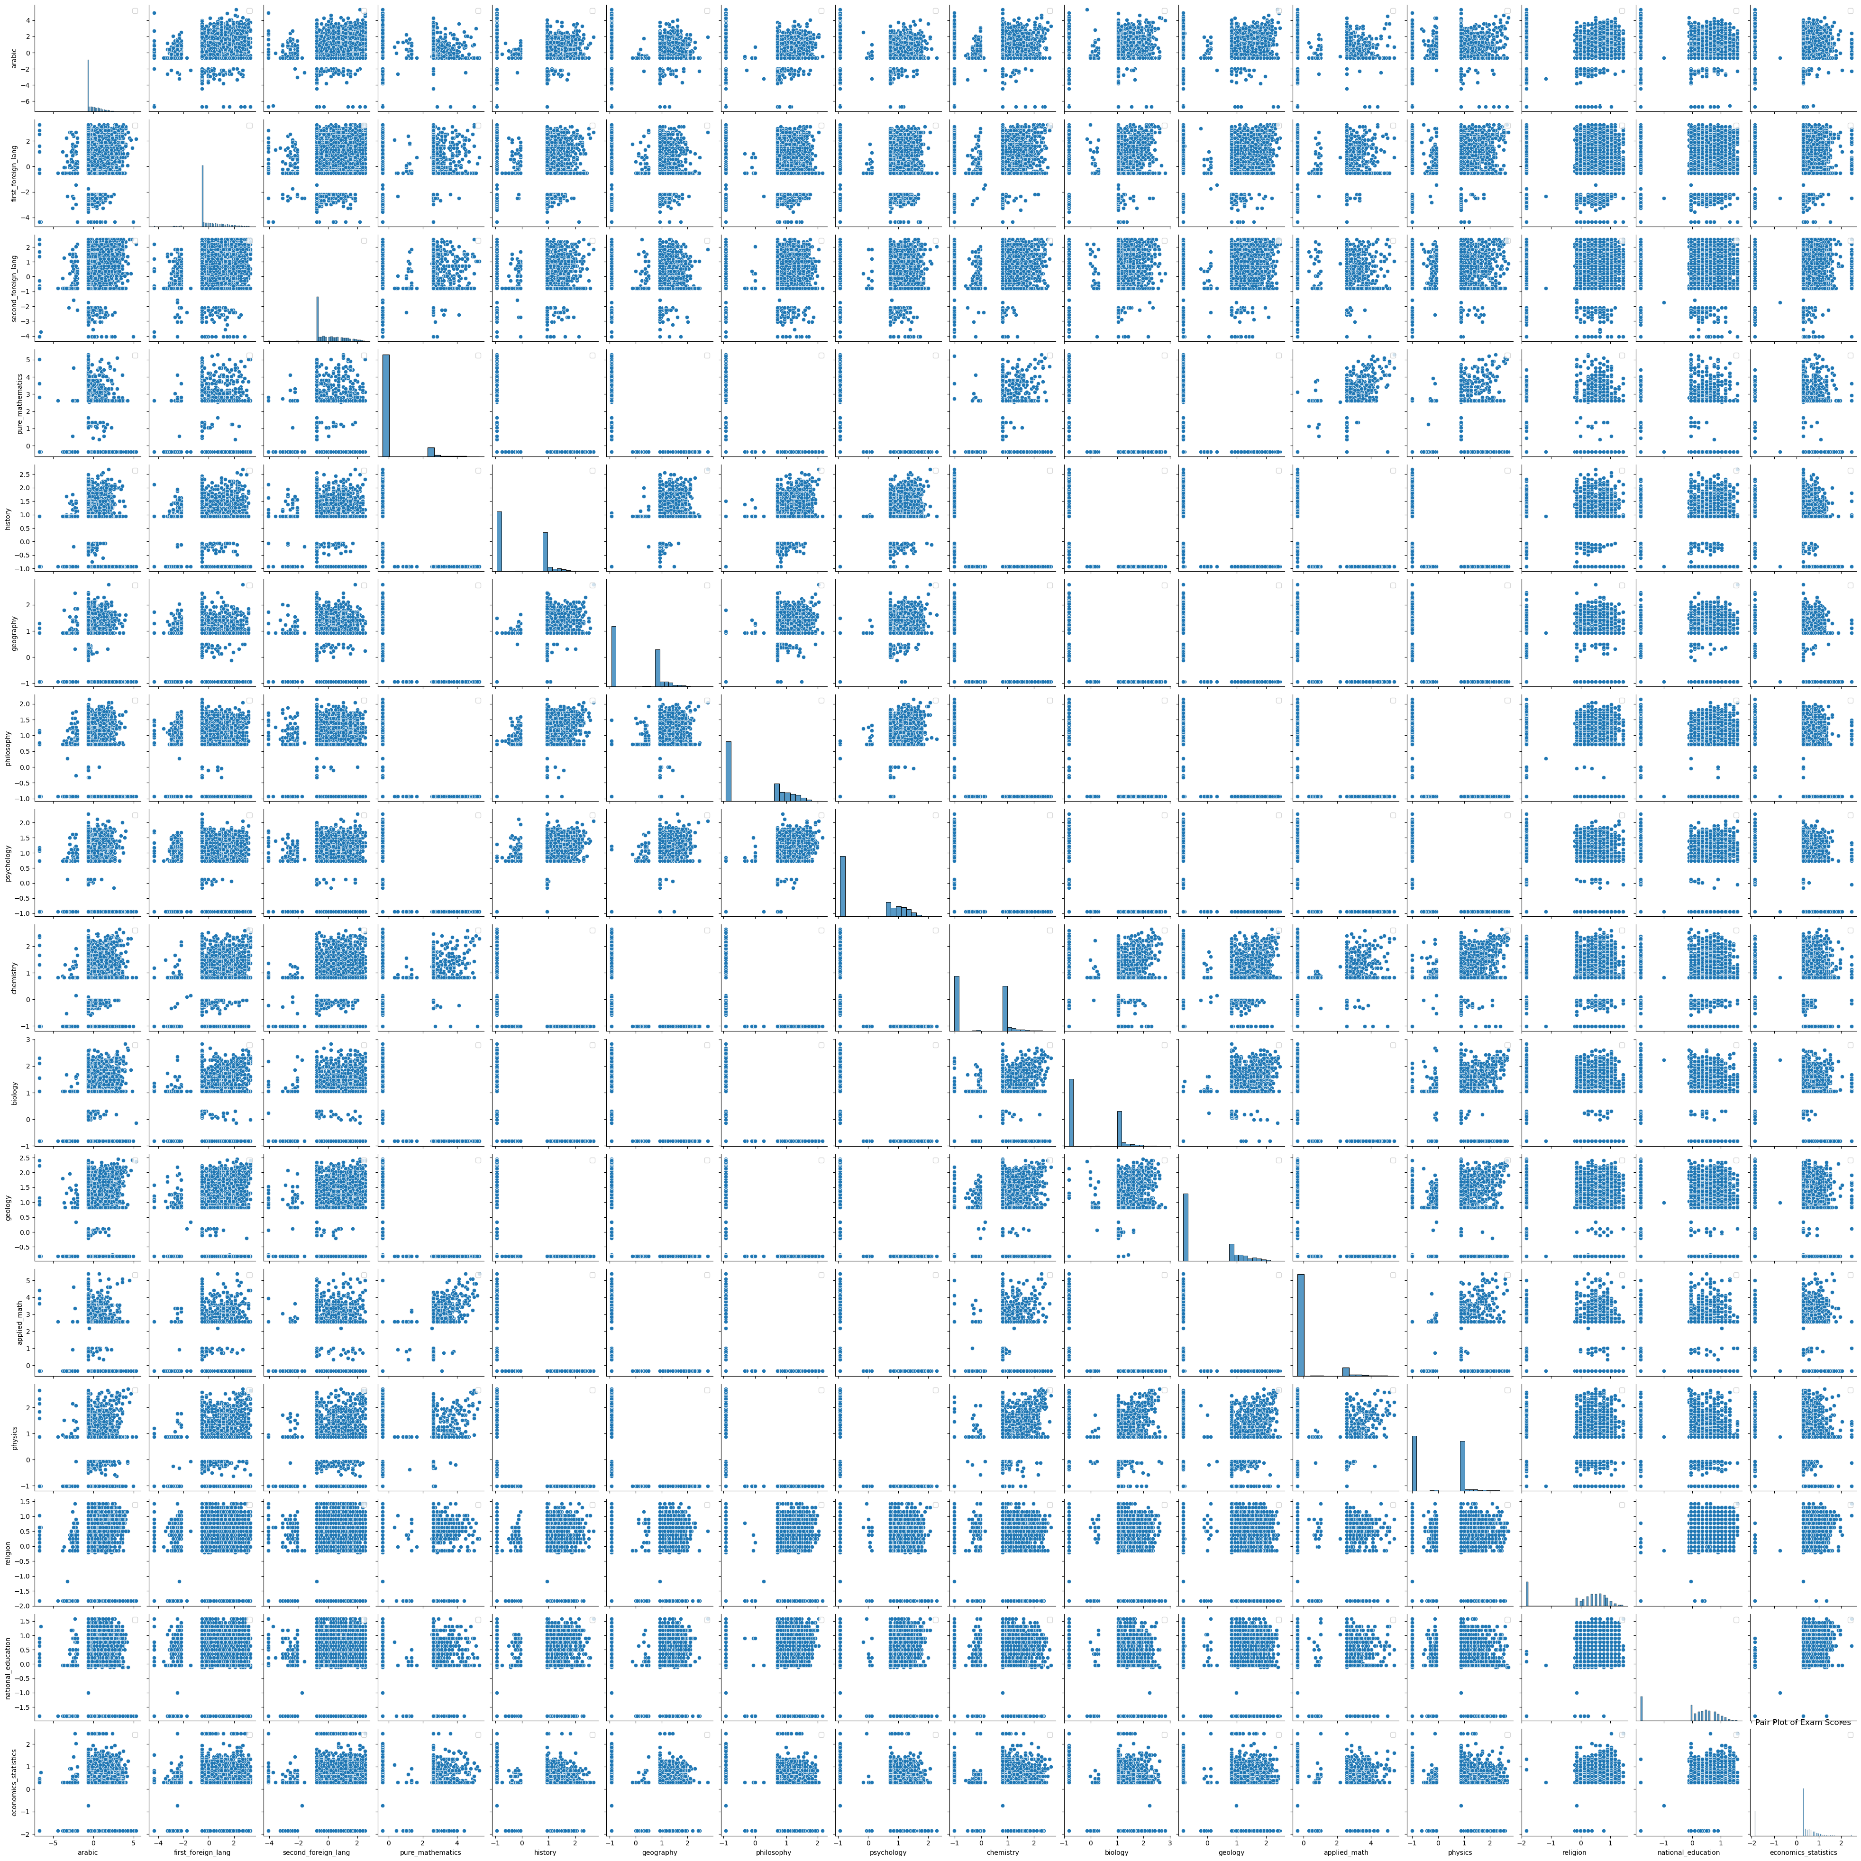
3.4 The relationship between each subject and grouping similar ones ( Hierarchical )
This is the relationship of each subject to the afterlife in a graphic form
Any NaN values ​​have been defaulted to zero, so we will notice a large amount of outliers, especially for specialized materials

Slide 40
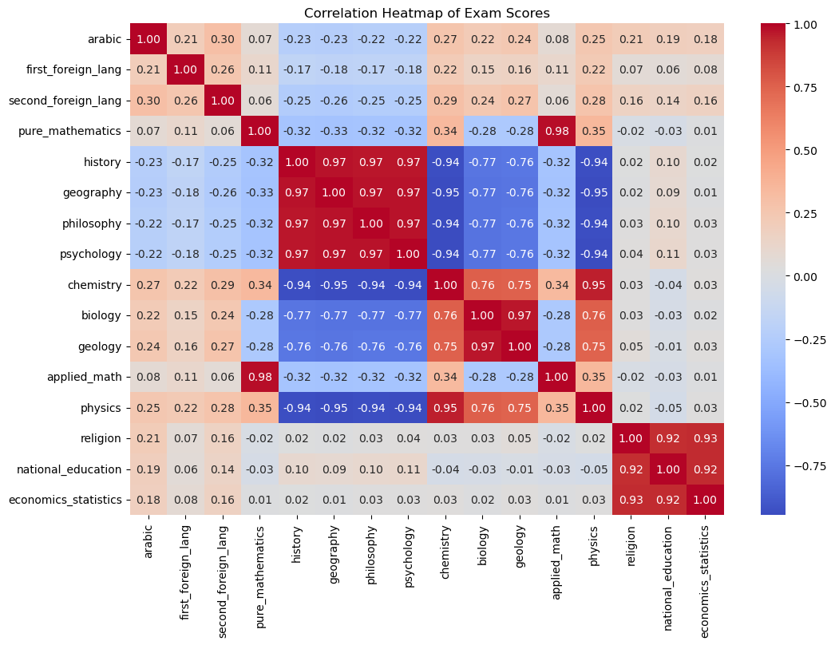
3.4 The relationship between each subject and grouping similar ones ( Hierarchical )
This is the correlation matrix, which shows the previous graph, but with numbers that we normalized using StandardScaler, and information can be extracted from it more easily.
The strongest relationships:
Pure and applied mathematics
Chemistry with physics
Biology with geology
The four literary subjects
The three subjects outside the final total

Slide 41
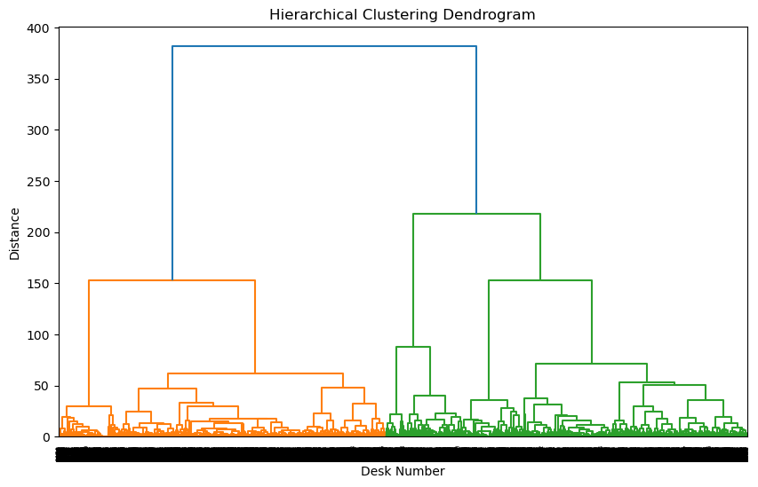
3.4 The relationship between each subject and grouping similar ones ( Hierarchical )
This dynamic diagram shows the interconnections between the primary groups with each other and the latter with each other
Which indicates that the first data includes one category and the last another category, which are close in level
The first category is Lower Egypt Giza, Beni Suef, Cairo and Alexandria
The last category is Upper Egypt, which includes Minya, Assiut, and Sohag

Slide 42
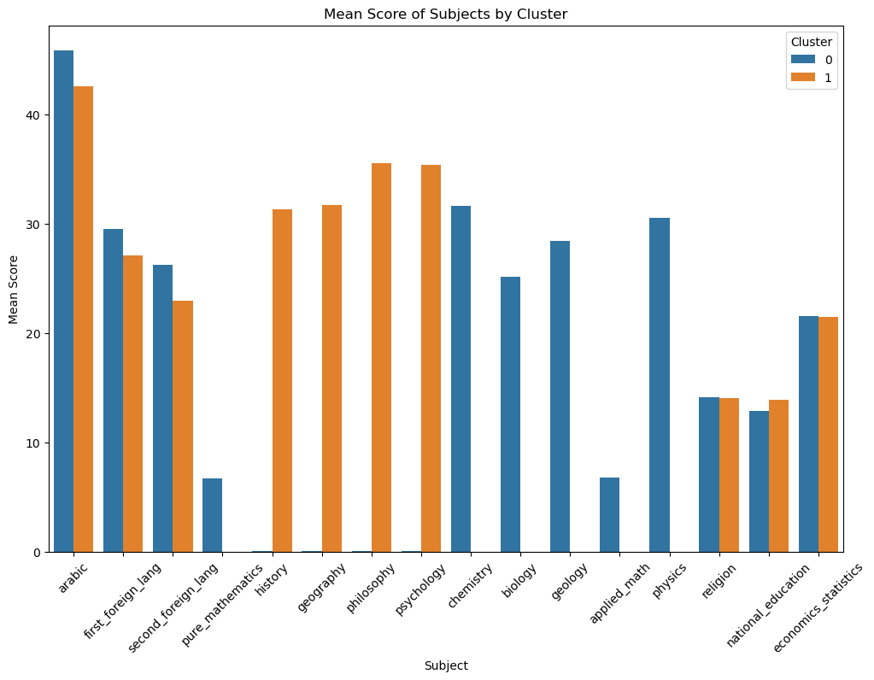
3.4 The relationship between each subject and grouping similar ones ( Hierarchical )
This graph is divided for each subject according to how closely it belongs to the clusters, whether 0 or 1
This shows that scientific materials clearly belong to Cluster 0
While literary materials clearly belong to Cluster 1
As for the common subjects, they differ, as the language exams are closer to Cluster 0, while the subjects outside the final score are close to Cluster 0 and 1 together.

